Slide 1
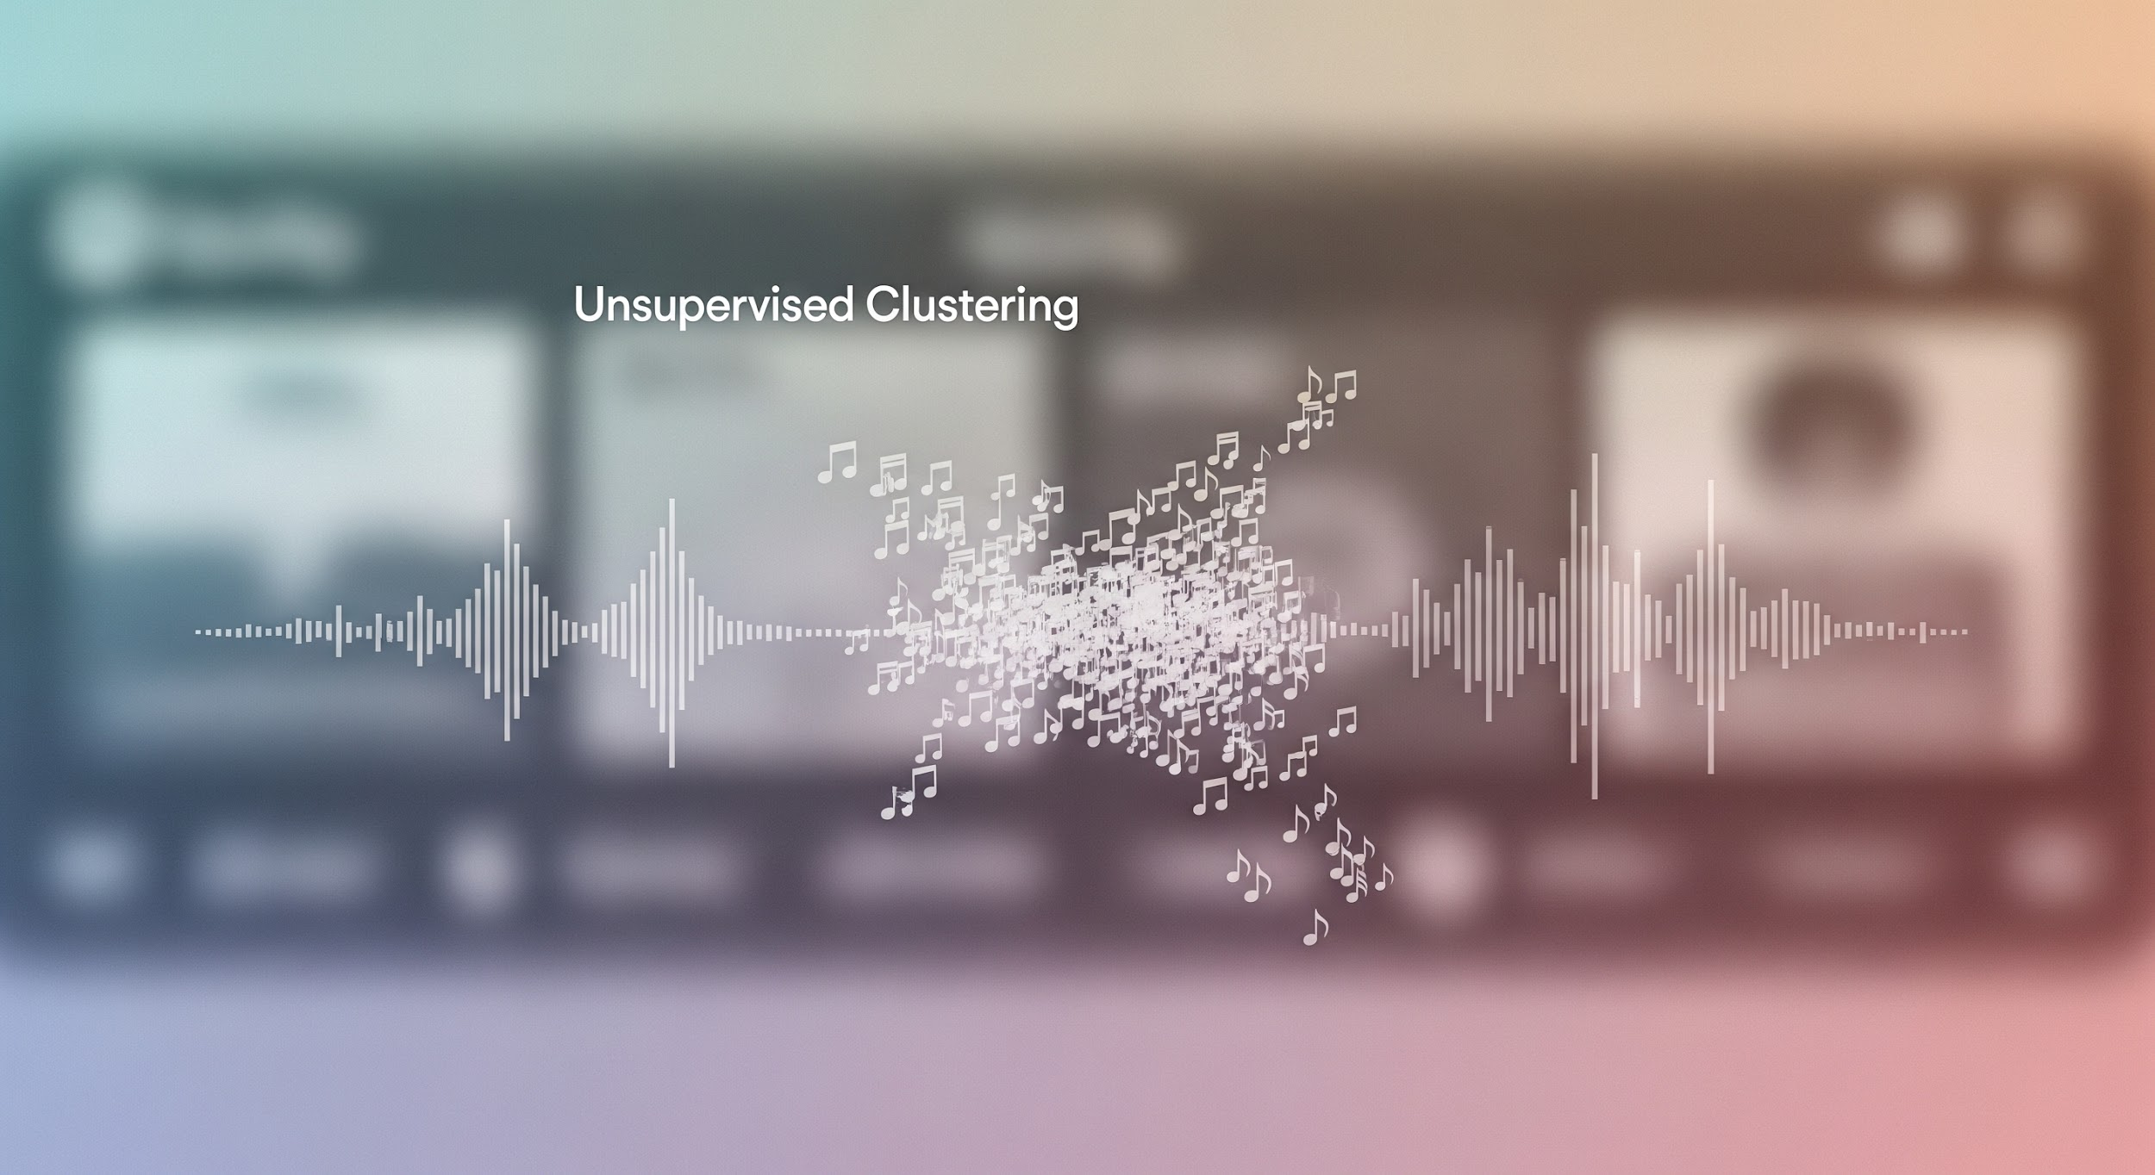
Using ML For Playlist Creation?
Playlist Creation Prototype
Olaf Bulas
Carlos Montefusco-Pereira

Slide 2

The Moosic Opportunity
Pain
Manual curation takes time
Approach
Cluster songs with UML
Outcome
Faster, consistent playlists

Slide 3
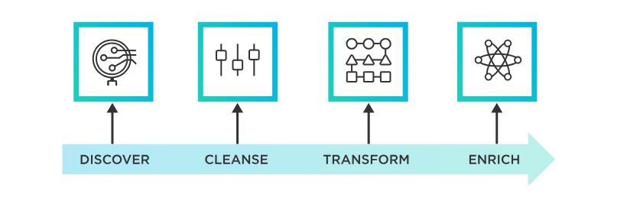
How we created the prototype
Features:
artist , song_name, danceability, energy, key, loudness, mode, speechiness, acousticness, instrumentalness, liveness, valence, tempo, duration_ms, time_signature, id, html
Data Preparation: Sourced a dataset (5000 songs) of audio features from the Spotify API.

Slide 4
How we created the prototype
Data Preparation
Algorithm Selection: Applied clustering algorithms to automatically group similar songs.

Slide 5
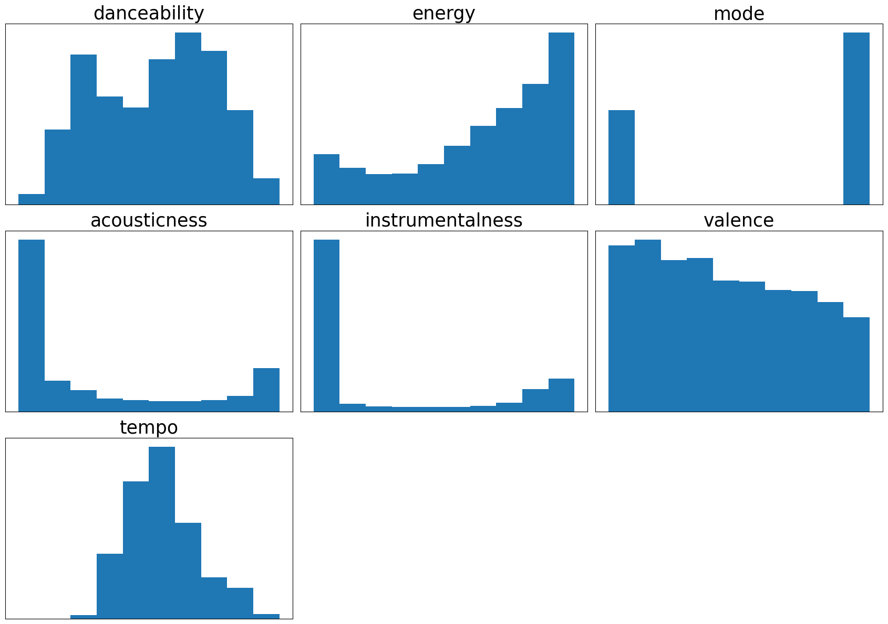
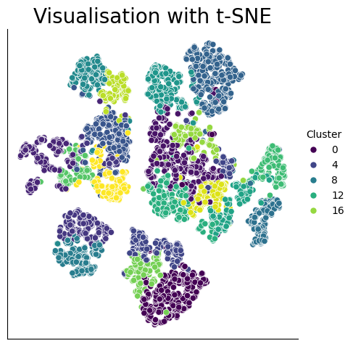
Algorithm
Agglomerative
Clustering
(14-28 clusters)
No - KMeans - DBScan
No - PCA
SKEWED
Quantile Transformation
n = 20 -> Well-defined clusters

Slide 6

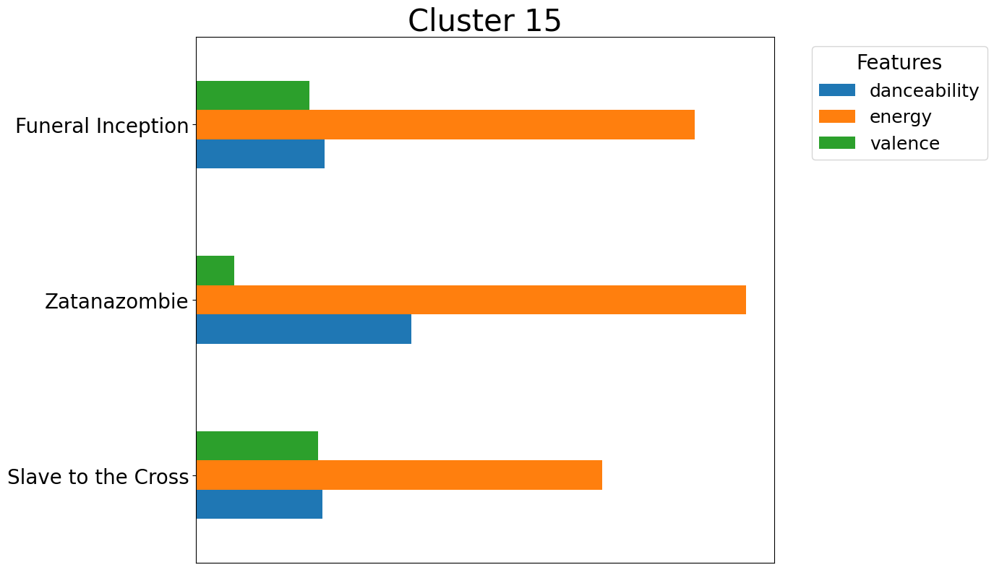
Identifying Song Similarity
A Clear, Repeatable Pattern Emerges
This is a human recognizable “Death Metal” playlist

Slide 7

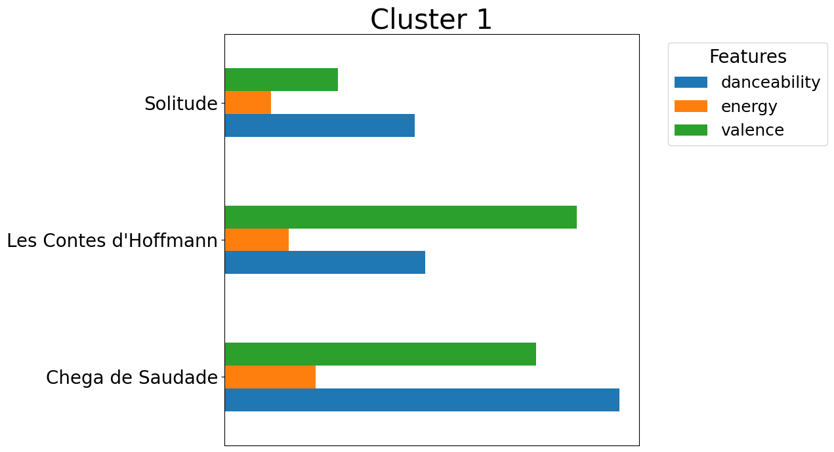


Identifying Song Similarity
Limitations using patterns - mixing up genres
Feature dependency

Slide 8
Other data that could improve playlist creation
🎧 “Liked songs” in Spotify: help decide to keep songs in playlist as preferred
🕒 Environment: if going to Gym, users may prefer “danc-y” songs
👥 Age of users: even though data may vary widely (e.g. return of “cult” songs, Kate Bush in Stranger Things)
📅 Song’s release year: nostalgia may influence on playlist choice
💬 Lyrics ‘sentiment’: sad, positive, aggressive..

Slide 9
Recommendation
Unsupervised machine learning can boost productivity by providing an initial, time-saving structure for playlists. While this initial structure provides a solid foundation, it will require further refinement through algorithm adjustments and combinations of them, supervised machine learning and manual review by our team.

Slide 10
The number of playlists (clusters)
20 playlists provided the optimal balance, successfully separating genres for a cleaner listening experience.
Fewer than 20 playlists resulted in an increase in mixed-genre lists (e.g., death metal and rock combined).
More than 20 playlists created unwanted over-segmentation, dividing single genres like hip hop into too many unnecessary lists.

Slide 11
Is unsupervised machine learning suitable?
K-Means ⚡✅
• Fast, easy to explain via centroids ('vibes')
• Centroid may not match a real track
Agglomerative 🧱🧭
• Shows hierarchy, and flexibility of features (e.g. energetic rock)
• Explainability harder; must choose cut height
DBSCAN 🔎🧹
• Marks noise/outliers
• Sensitive to ε/min_samples; fiddly tuning

